Slide 1
T-PESS Principal Orientation Meeting
T-PESS
Principal
Orientation
Training
Notes:
Half-Day Orientation—Open with Welcome / Introductions (if needed)
3 minutes
Note to Trainers:
This T-PESS Orientation Training is intended to support districts that are preparing to implement T-PESS and desire to deepen their principals’ understanding of the system by which they will be evaluated. Even if principals attended the Two-Day T-PESS training previously, an orientation that provides additional local information on key elements of the T-PESS process may be beneficial and can serve to enhance the collegial dialogue that is at the core of the T-PESS process.
Districts may design or customize their own orientation for T-PESS. This module is as an example that meets the orientation requirement in the Education Code below.
§150.1025. Principal Orientation.
(a) A school district shall ensure that a principal is provided with an orientation of the Texas Principal Evaluation and Support System (T-PESS) either prior to or in conjunction with the pre-evaluation conference, as referenced in §150.1023(b)(2) of this title (relating to Appraisals, Data Sources, and Conferences) when:
(1) the principal is new to the district;
(2) the principal has never been appraised under the T-PESS; or
(3) district policy regarding principal appraisal has changed since the last time the principal was provided with an orientation to the T-PESS.
(b) The principal orientation shall include all state and local appraisal policies and the local appraisal calendar.

Slide 2
Purpose & Outcomes
Purpose: To clarify the expectations and process for T-PESS.
Principals will understand:
The T-PESS evaluation system
Expectations for Principals
How performance will be measured on the rubric
How to use the associated materials (forms, etc.) with assistant principals.
The T-PESS process: BOY, MOY & EOY
Recognition this is an on-going process designed to promote professional growth
Notes:
2 minutes
Read through slide:
The purpose of this orientation module is to ensure that Principals will understand:
The T-PESS evaluation system
Expectations for Principals/Appraisees
How performance will be measured on the rubric
How to use the respective materials (forms, etc.)
The T-PESS process is annual and on-going: BOY, MOY & EOY
The T-PESS process designed to promote professional growth

Slide 3
Materials
T-PESS Principal Rubric (Update 2020)
T-PESS Principal Handbook
T-PESS Principal Self-Assessment and Goal Setting Form
Assistant Principal Forms
(Note: Assistant Principal forms are also available.)
Notes:
2 minutes
(Participants should have copies of the materials.)
Make sure participants have these materials, plus a highlighter.

Slide 4
Why?
Descriptor language provides clarity and specificity in the practices described and a progression of implementation across performance levels.
Preponderance of evidence approach to ratings versus the additive/cumulative approach.
Clear alignment to the Texas Principal Standards and the Effective Schools Framework campus-based best practices.
Streamline the forms and processes for both the principal and principal appraiser.
Notes:
3 minutes
Read through slide and elaborate as follows:
Both the rubric and the Principal Handbook work together to clarify the principal practices for each domain and across performance levels.
The previous rubric used an additive/cumulative scoring system which sometimes didn’t accurately measure the progression of practices. The new rubric shows the practices across performance levels as levels of implementation and impact. As with T-TESS, the new system uses preponderance of evidence to determine performance levels.
The updated rubric is aligned to the Texas Principal Standards and the Effective Schools Framework which is used statewide to highlight best practices with school leadership and improvement.
The system, overall, has been streamlined for ease of use with scoring and tracking.

Slide 5
Agenda
Unpacking the Rubric and Connecting the Principal Handbook
Self-Assessment and Goal Setting
Principal Responsibilities
Appraiser Responsibilities
Know the Narrative
Notes:
2 minutes
Review the agenda items on the slide.
Remind participants that the T-PESS Rubric is the driver for this work. The orientation is intended to ensure that principals understand the rubric and embedded practices.

Slide 6
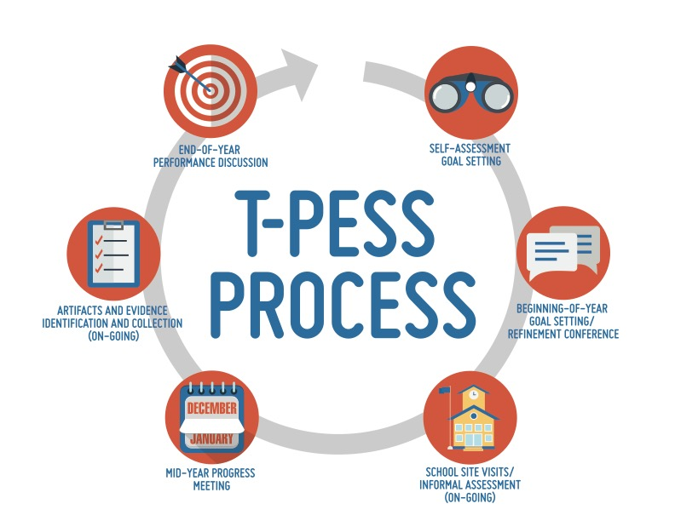
Evaluation System Process
Notes:
2 minutes
Walk through the T-PESS graphic with the audience.
The T-PESS process includes various formative steps that results in an annual summary assessment of the principal. It is intended and best used as a growth-based model based on an annual process of actions and activities that self-assess, establish performance goals, collect and analyze information, and provide constructive feedback resulting in the improvement and refinement of practice.
T-PESS is intended to improve the quality and effectiveness of the principal through their personal involvement in the process, along with that of their supervisor or appraiser.

Slide 7
Step 1: Orientation
This session is your ORIENTATION to T-PESS.
Notes:
2 minutes
We are currently conducting the orientation, so we are in the initial step.
At the beginning of each year, an orientation is conducted with all principals to clarify the T-PESS rubric, along with the district’s expectations for practice and performance, timelines, materials, forms, and any additional rollout information. The orientation is an important step in the process, because it:
- provides the appraiser and principal with concise and accurate information regarding T-PESS, including the actions embedded in the rubric;
- ensures that the appraiser and principal understand individual roles and responsibilities;
- details the T-PESS process and provides specific timelines for when required activities are due;
- communicates any regulations and policies that govern principal evaluations; and
- clarifies how performance will be measured.

Slide 8
Aligned Approach to T-PESS: Principal Standards, ESF, TIL, T-TESS & AEL
Personify Continuous Growth and Improvement
Guide Self-Reflection and Goal Setting
Intentional Professional Development
Improve Leadership Quality through Coaching
Notes:
2 minutes
As a reminder, T-PESS was developed to align with these defining priorities. The priorities supported a theory of action that informed the development of the performance rubric and these purposes will be emphasized in the professional development that accompanies implementation. The system is now aligned with the principal standards, the Effective Schools Framework, the Texas Instructional Leadership program, T-TESS, and AEL, or the Advanced Educational Leadership program.
Successful implementation of the system is dependent upon attending to the priorities, which should be treated as guiding principles for the evaluation system.
Emphasize this model is predicated on growth and development - NOT rank ordering leadership performance.
The model is meant to guide professional development for principals.
Serve as a tool in developing coaching and mentoring programs for principals.
The implementation and evaluation of the system must embody continuous improvement.
Provide meaningful and credible feedback that improves performance.
The development and implementation of the evaluation systems must continue to involve stakeholders in a collaborative process.

Slide 9
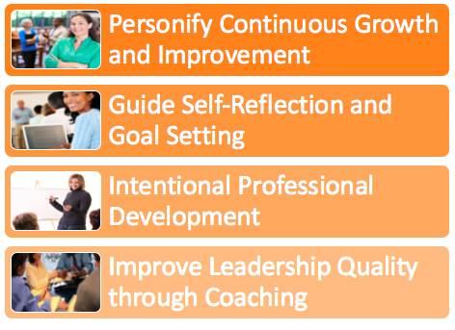
Discuss T-PESS Priorities
Discussion
What do you personally see as the value with this alignment?
Notes:
2 minutes
Discussion: What do you personally see as the value with this alignment?
If using Zoom: Raise your hand on the Zoom screen to respond--volunteer.

Slide 10
Princl (Appraisee) Expectations
Expectations for Principal (Appraisee)
Know and understand the Principal Leadership Responsibilities.
Understand T-PESS.
Prepare for and fully participate in each component of the evaluation process.
Gather data, artifacts, and/or evidence to demonstrate performance in relation to leadership responsibilities and progress in attaining goals.
Develop and implement strategies to improve personal performance/ attain goals in areas individually or collaboratively identified.
Notes:
3 minutes
Go through the slide:
For T-PESS to fulfill the purpose of evaluation and realize the key priorities of the Texas Principal Evaluation Steering Committee, principals need to:
Know and understand the Principal Leadership Responsibilities.
Understand T-PESS.
Prepare for and fully participate in each component of the evaluation process.
Gather data, artifacts, and/or evidence to demonstrate performance in relation to leadership responsibilities and progress in attaining goals.
Develop and implement strategies to improve personal performance/ attain goals in areas individually or collaboratively identified.

Slide 11
T-PESS Rubric Design
Domain
Broad standard of principal leadership practice
Indicator
Essential area or characteristic of the domain
Performance Level
Assessment of performance or level of implementation of principal practice based on descriptors
Performance Descriptors
Descriptors of the essential actions of principal leadership practice
Notes:
5 minutes
The rubric design is tiered with four levels:
(review the slide)…
Note that the rubric has shifted from Standards to Domains.

Slide 12
T-PESS Rubric Design - 2
Domain
Indicator
Performance Level
Descriptors
Notes:
5 minutes
Let’s review the four levels with a specific indicator of the rubric.
Review the slide and note the clicks.
Each domain is followed by two to five supporting indicators and their definitions.
Each indicator contains a number of leadership practices that are organized across a scale of performance levels beginning with “Distinguished” and progressing through “Needs Improvement”. Rather than beginning with a rating of “Unsatisfactory” or “Ineffective,” attempting to describe what leaders don’t know or are not able to do, the T-PESS rubric design exemplifies a growth model approach to performance improvement.
The T-PESS rubric contains the performance descriptors—the leadership responsibilities and evidence-based practices that communicate and differentiate leadership across the scale of performance levels. Taken together, these generate a robust set of practices that help guide leaders to higher levels.
(With the Star) Note that the Distinguished level of performance is gray-scaled to separate it from the Developing, Proficient, and Accomplished levels. This performance is representative of the top performing principals in the system.

Slide 13
Performance Levels
Distinguished | Describes an exemplary level of performance that has a profound impact on both campus- and district-level performance. These exhibited practices serve as an exemplar for other principals and campus leaders and represents a distinct group of principals. Direct comment is required.
Accomplished | Describes highly skilled level of competence and automaticity with practices and performance that exceed proficiency.
Proficient | Describes demonstrated competence with practices and performance with expected proficiency of the standard.
Developing | Describes basic competence with practices and performance and requires direct oversight and/or growth toward achieving the standard at the proficient level.
Needs Improvement | Describes subpar competence with practices and performance and requires immediate growth. Direct comment is required.
Notes:
3 minutes
Let’s now look at the performance levels. T-PESS performance levels exemplify a growth model evaluation system. The ordinal rankings have specific definitions.
We begin with:
Developing— Describes basic competence with practices and performance and requires direct oversight and/or growth toward achieving the standard at the proficient level.
Proficient—Describes demonstrated competence with practices and performance with expected proficiency of the standard.
Accomplished—Describes highly skilled level of competence and automaticity with practices and performance that exceed proficiency.
Distinguished—Describes an exemplary level of performance that has a profound impact on both campus- and district-level performance. These exhibited practices serve as an exemplar for other principals and campus leaders and represents a distinct group of principals. As stated earlier, this represents a unique subset of principals in the system.
Needs Improvement—Describes subpar competence with practices and performance and requires immediate growth It may also be used to indicate that the skill was not demonstrated.
CLICK
Both the Distinguished and Needs Improvement levels require direct comment.
These tiered performance levels encourage novice school leaders as they learn and develop their leadership abilities. At the same time, this encourages and inspires experienced leaders to continue to develop and hone their instructional leadership skills. However, it is important to realize that over time, evaluation results will be used in making important resource allocation decisions, such as professional development and continuing status decisions.

Slide 14
T-PESS Rubric High-Level Review of Domains
Domain 1
Strong School Leadership and Planning
Domain 2
Effective, Well-Supported Teachers
Domain 3
Positive School Culture
Domain 4
High-Quality Curriculum
Domain 5
Effective Instruction
Notes:
5 minutes
Domains of the T-PESS Rubric
Before you begin the transitions in this slide, ask the audience to be thinking about the significance of each Domain and the magnitude of what is being expected of principals.
Give them a minute to read the screen, then…
The “T-PESS Rubric is constructed with 5 Domains which align to the Principal Standards and the Effective Schools Framework. As you know from your previous training, these five (5) standards represent the goals Texas principals strive towards. The standards and the corresponding indicators, knowledge, and skills are designed to be aligned with the training, appraisal, and professional development of principals.
The Texas Principal Standards which comprise the T-PESS rubric are ALL ABOUT INSTRUCTION and there was extensive discussion about how to order the Domains.
Note to Facilitator
The Texas Education Agency (TEA) and the Principal Advisory Committee completed new principal standards in 2013. These new standards (see Appendix A) are found in Chapter 149 of the Texas Administrative Code and are expected to serve as the foundation for the new leadership appraisal and support system. (Texas Administrative Code (TAC), Title 19, Part II Chapter §149.2001: Commissioner’s Rules Concerning Educator Standards: Principal Standards. Retrieved from (http://ritter.tea.state.tx.us/rules/tac/chapter149/)

Slide 15
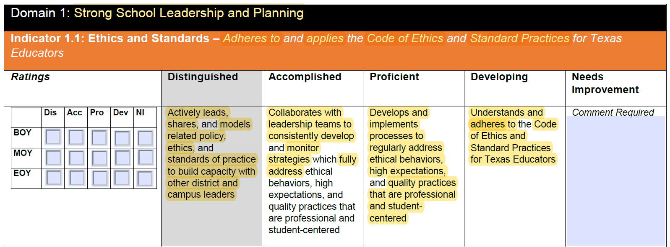
Unpacking the Rubric
Notes:
5 minutes
The T-PESS Rubric is the driver for the process; therefore, a large segment of the training will be spent on unpacking the rubric and making connections with the new Principal Handbook which further clarifies essential actions and practices.
Ask participants to have their rubric, Principal Handbook, highlighter and pen ready.
We will start with an “I do” or a “See It” in action activity. Turn to Domain 1 – School Leadership and Planning, and Indicator 1.1 – Ethics and Standards.
Using the highlighter, I’m looking at Domain 1 and will highlight the essence of this domain, which is school leadership and planning.
Moving down to the indicator, it reads: Indicator 1.1 – Ethics and Standards – Adheres to and applies the Code of Ethics and Standard Practices for Texas Educators. I’m going to highlight Code of Ethics and Standard Practices to indicate that this is the focus of the indicator.
Next, we will look at the descriptors or practices for each performance level of this indicator. Starting with Developing and moving towards the left, it reads “Understands and adheres to the Code of Ethics and Standard Practices for Texas Educators.
I highlighted the key words.
Shifting to the Proficient level, it reads “Develops and implements processes to regularly address ethical behaviors, and quality practices that are professional and student-centered.” Again, I highlight the changes and make note of “regularly”.
In the Accomplished level, I highlight “Collaborates with leadership teams to consistently develop and monitor strategies which….” Two words that stand out are consistently and fully.
In the Distinguished level, I highlight “Actively leads, shares, and models related policy, ethics, and standards of practice to build capacity with other district and campus leaders. “ The practice here is a heightened level of implementation with a larger system impact.

Slide 16
Domain 1
Individually unpack the following:
Indicators 1.2 through 1.5
Rubric pages 3-6
7 minutes
Highlight the focus of the Indicator:
Starting at Proficient and moving towards Distinguished, highlight the changes in the descriptors.
Go back to Developing and review the practices compared to the Proficient level of performance.
Be prepared to share in small groups.
Notes:
8 minutes
Participants unpack Domain 1 per the slide.

Slide 17
Small groups
Remember your group number.
Identify a facilitator.
Review the four indicators: 1.2 – 1.5.
What did you highlight? Why?
How do the descriptors/principal actions change and develop across performance levels from Developing to Distinguished?
Notes:
10 minutes in small groups
3 minutes whole group debrief after small groups
Participants debrief in small groups. Use cold call in small groups and then have some share when they return to whole group.

Slide 18
Principal Handbook
Purpose: To assist in clarifying and unpacking the rubric, including how the indicators and descriptors are represented through essential leadership actions.
These clarifications allow for deeper dialogue between the principal and principal supervisor.
Notes:
2 minutes
Review the slide.

Slide 19
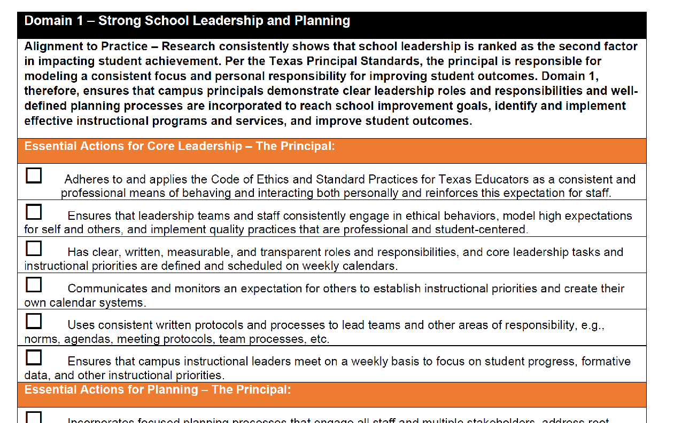
Principal Handbook - 2
Notes:
1 minute
Introduce the Principal Handbook.

Slide 20
Principal Handbook - 3
Individually read through pages 6 and 7 of the T-PESS Principal Handbook.
Compare the Essential Actions to the Indicators and Descriptors of the Rubric in this domain.
How does the Handbook further clarify the rubric?
Be prepared to share in small groups.
Notes:
3 minutes
Process per the slide. Reassign participants to the same small group.

Slide 21
Sources of Evidence
T-PESS Rubric - page 6
Review the Sources of Evidence.
How do these sources support the domain of School Leadership and Planning?
Notes:
2 minutes
Have participants read and cold call to share reflections.

Slide 22
Domain 2 – Effective, Well-Supported Teachers
Individually unpack the following:
Indicators 2.1 through 2.4
Rubric pages 7-10
6 minutes
Highlight the focus of the Indicator:
Starting at Developing and moving towards Distinguished, highlight the changes in principal actions.
Be prepared to share in small groups.
Notes:
7 minutes
Following Break – Begin to process Domain 2 using the same processes as Domain 1.

Slide 23
Small Groups
Identify a new facilitator.
Review the four indicators: 2.1 – 2.4.
What did you highlight? Why?
How do the principal actions change and develop across performance levels from Developing to Distinguished?
Notes:
5 minutes
Process per the slide in small groups.

Slide 24
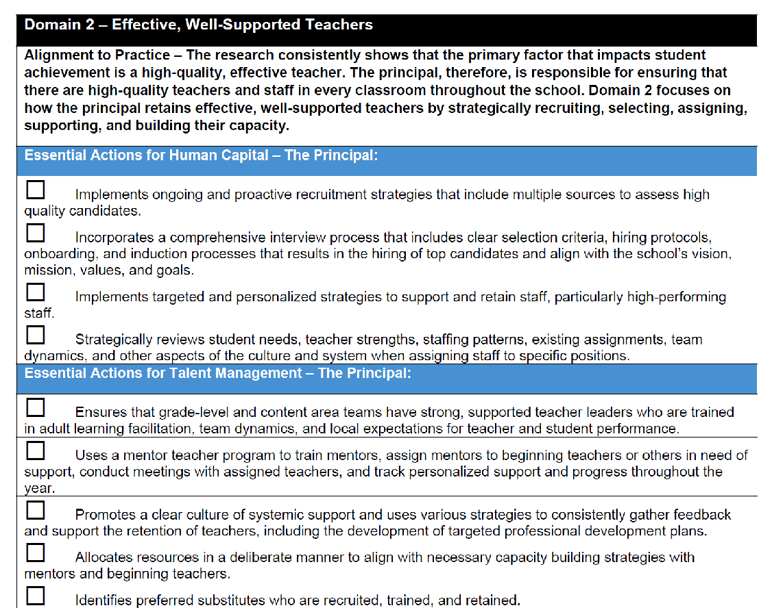
Principal Handbook - 4
Notes:
1 minute
Refer to this section of the Principal Handbook.

Slide 25
Principal Handbook - 5
Individually read through pages 8 and 9 of the T-PESS Principal Handbook.
Compare the Essential Actions to the Indicators and Descriptors of the Rubric.
How does the Handbook further clarify the rubric?
Be prepared to share in small groups.
Notes:
9 minutes
Process per the slide. Send participants to the same small groups as Domain 1.

Slide 26
Sources of Evidence - 2
Rubric Page 10.
Review the Sources of Evidence.
How do these sources support the domain of Effective, Well-Supported Teachers?
Notes:
2 minutes
Process per the slide.

Slide 27
Domain 3 – Positive School Culture
Individually unpack the following: :
Indicators 3.1 through 3.4
Rubric pages 11-15
6 minutes
Highlight the focus of the Indicator
Starting at Developing and moving towards Distinguished, highlight the changes in principal actions.
Be prepared to share in small groups.
Notes:
8 minutes
Process per the slide. Send participants into new small groups after this analysis.

Slide 28
Small Groups - 2
Identify a new facilitator.
Review the four indicators: 3.1 – 3.4.
What did you highlight? Why?
How do the principal actions change and develop across performance levels from Developing to Distinguished?
Notes:
10 minutes
Process per the slide and send participants into new small groups for this Domain and Domain 4.

Slide 29
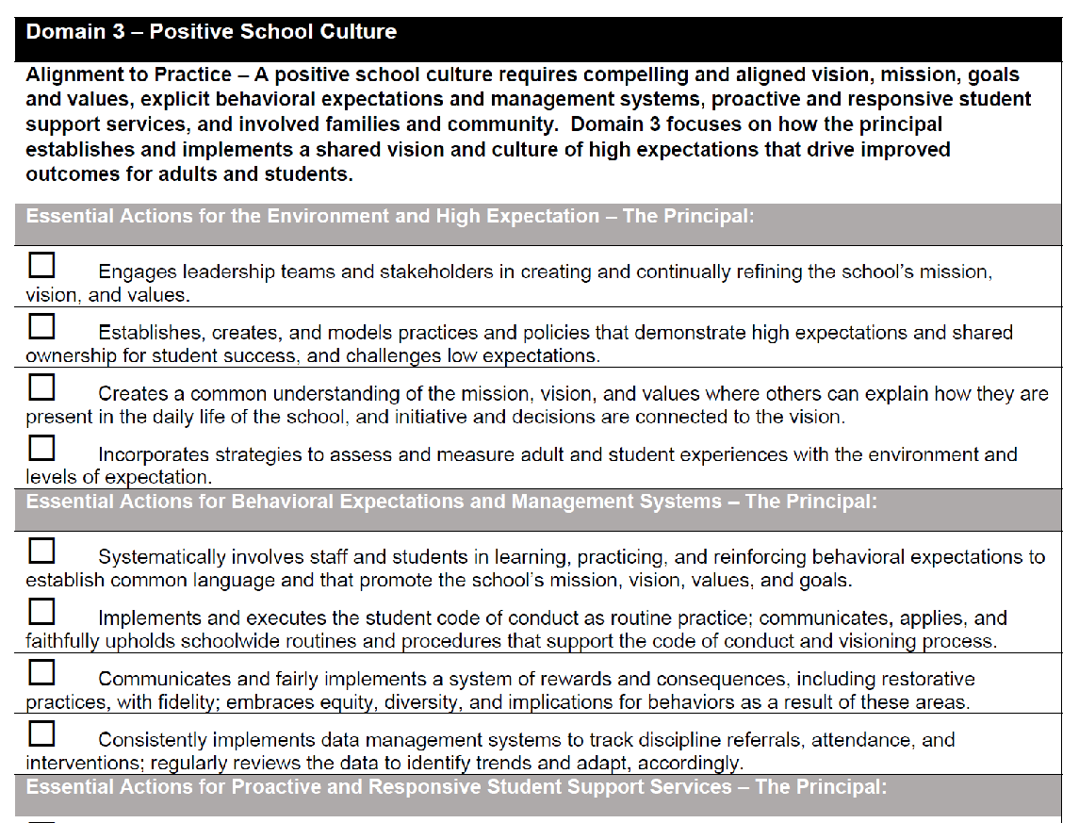
Principal Handbook - 6
Notes:
1 minute
Direct participants to this section of the Principal Handbook.

Slide 30
Principal Handbook - 7
Individually read through pages 10 and 11 of the T-PESS Principal Handbook.
Compare the Essential Actions to the Indicators and Descriptors of the Rubric.
How does the Handbook further clarify the rubric?
Be prepared to share in small groups.
Notes:
6 minutes
Process per the slide. Send participants back to small groups to process.

Slide 31
Sources of Evidence - 3
Rubric Page 15.
Review the Sources of Evidence.
How do these sources support the domain of Positive School Culture?
Notes:
2 minutes
Process per the slide.

Slide 32
Domain 4 – High Quality Curriculum
Individually unpack the following:
Indicators 4.1 and 4.2
Rubric pages 16-17
4 minutes
Highlight the focus of the Indicator:
Starting at Developing and moving towards Distinguished, highlight the changes in principal actions.
Be prepared to share in small groups.
Notes:
4 minutes
Process per the side for Domain 4.

Slide 33
Small Groups - 3
Identify a new facilitator.
Review the four indicators: 4.1 and 4.2.
What did you highlight? Why?
How do the principal actions change and develop across performance levels from Developing to Distinguished?
Notes:
5 minutes
Process per the slide in small groups.

Slide 34
Principal Handbook - 8
Notes:
1 minute
Direct participants to this section of the Principal Handbook.

Slide 35
Principal Handbook - 9
Individually read through page 12 of the T-PESS Principal Handbook.
Compare the Essential Actions to the Indicators and Descriptors of the Rubric.
How does the Handbook further clarify the rubric?
Be prepared to share in small groups.
Notes:
3 minutes
Process per the slide. Send participants to the same small groups as prior.

Slide 36
Sources of Evidence - 4
T-PESS Rubric - page 17
Review the Sources of Evidence.
How do these sources support the domain of High Quality Curriculum?
Notes:
2 minutes
Process per the slide. Ask for reflections from participants.

Slide 37
Domain 5 – Effective Instruction
Individually unpack the following:
Indicators 5.1 through 5.5
Rubric pages 18-22.
7 minutes
Highlight the focus of the Indicator
Starting at Developing and moving towards Distinguished, highlight the changes in principal actions.
Be prepared to share in small groups.
Notes:
12 minutes
Process per the slide and send to third group.

Slide 38
Small Groups - 4
Identify a new facilitator.
Review the four indicators: 4.1 and 4.2.
What did you highlight? Why?
How do the principal actions change and develop across performance levels from Developing to Distinguished?
Notes:
12 minutes
Debrief in small groups. Cold call to debrief.

Slide 39
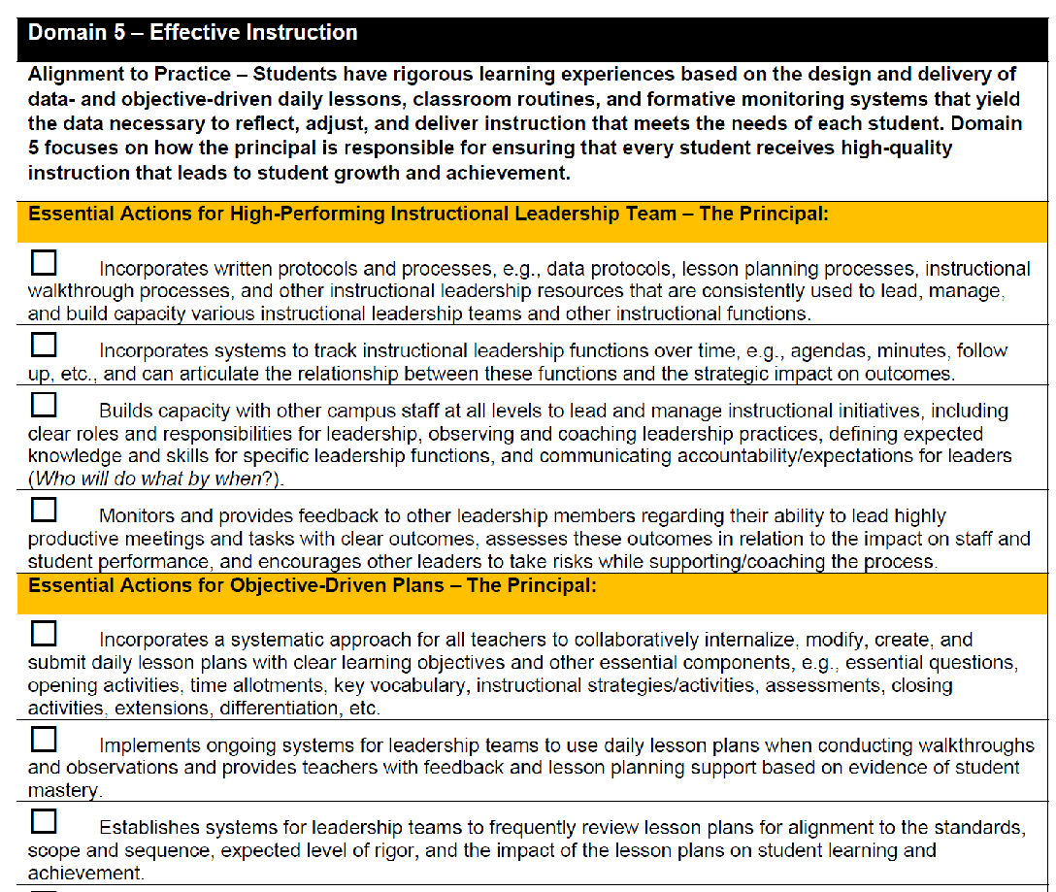
Principal Handbook - 10
Notes:
1 minute
Direct participants to this section of the Principal Handbook.

Slide 40
Principal Handbook - 11
Individually read through pages 13 - 14 of the T-PESS Principal Handbook.
Compare the Essential Actions to the Indicators and Descriptors of the Rubric.
How does the Handbook further clarify the rubric?
Be prepared to share in small groups.
Notes:
5 minutes
Participants read through this section of the Principal Handbook and make connections to the rubric’s descriptors.

Slide 41
Sources of Evidence - 5
Rubric Page 22.
Review the Sources of Evidence.
How do these sources support the domain of Effective Instruction?
Notes:
1 minute
Participants review the sources of evidence on page 22.

Slide 42
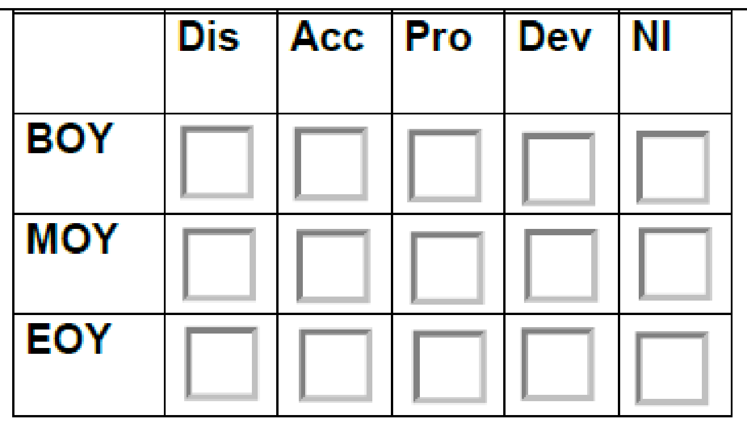
Rubric Wrap-Up
Scoring
Preponderance of Evidence
BOY, MOY, EOY
Notes:
2 minutes
Review the scoring information noted on the slide.
Re-emphasize preponderance of evidence.
Note the BOY, MOY, and EOY tables for each indicator. These EOY scores are used to complete the summative section of the forms.
Discuss the district’s scoring system.

Slide 43
Timelines
Appraiser Principal Both Appraiser Both Both Both
Notes:
2 minutes
Review the recommended timelines and how they apply to the appraiser, principal, or both, as noted on the slide.

Slide 44
Step 2: Self-Assessment and Goal Setting
Using the Texas Principal Standards, T-PESS Rubric, T-PESS Principal Guide, and data sources such as the campus needs assessment, campus improvement plan, district strategies and priorities, student and staff outcome data, and past feedback from peers and appraisers, the principal completes a data-driven self-assessment to identify the variances between actual and expected competence and performance.
Notes:
2 minutes
Take a minute to read about Step 2 on the slide.

Slide 45
Step 2: Self-Assessment and Goal Setting - 2
Notes:
3 minutes
Remind participants that principals will receive this document – Principal Self-Assessment and Goal Setting Forms.
Have the document available to scan with them. Note the introduction, rubric self-analysis for BOY (EOY will be available for them at the end of year to compare), and goal-setting template to draft their goals.

Slide 46
Self-Assessment and Goal Setting
Purpose: To reflect on past performance, feedback from supervisors and colleagues, and benchmark performance against the criteria in the evaluation rubric.
Each principal (appraisee) will complete a self-assessment at the beginning of every year.
The self-assessment provides the basis for goal setting and planning for professional development.
Notes:
2 minutes
Self-Assessment is one of the most important elements of the process for principals. This is where they think deeply about their own capacity and what they want to improve professionally.
While there are many reasons for conducting a self-assessment, the primary purpose here is to provide a solid foundation on which for collegial conversations about leadership, clarify expectations associated with performance improvement, and serve as the basis of goal setting and professional growth plans.
Principals deepen their understanding of the T-PESS rubric when they devote time to reading each standard and its related indicators to better under the level of performance that is expected.
Previous evaluation instruments may not have been as rigorous nor as comprehensive as the T-PESS rubric. Just like T-TESS, where more is being asked of teachers with regard to professional performance, T-PESS holds a very high standard for Principal performance.
T-PESS, like T-TESS uses an aspiration rubric—there is room for every principal, no matter how experienced, to grow with this instrument.
Ask: How comfortable were principals with the self-assessment they led with teachers? They will engage in the same reflective practice.

Slide 47
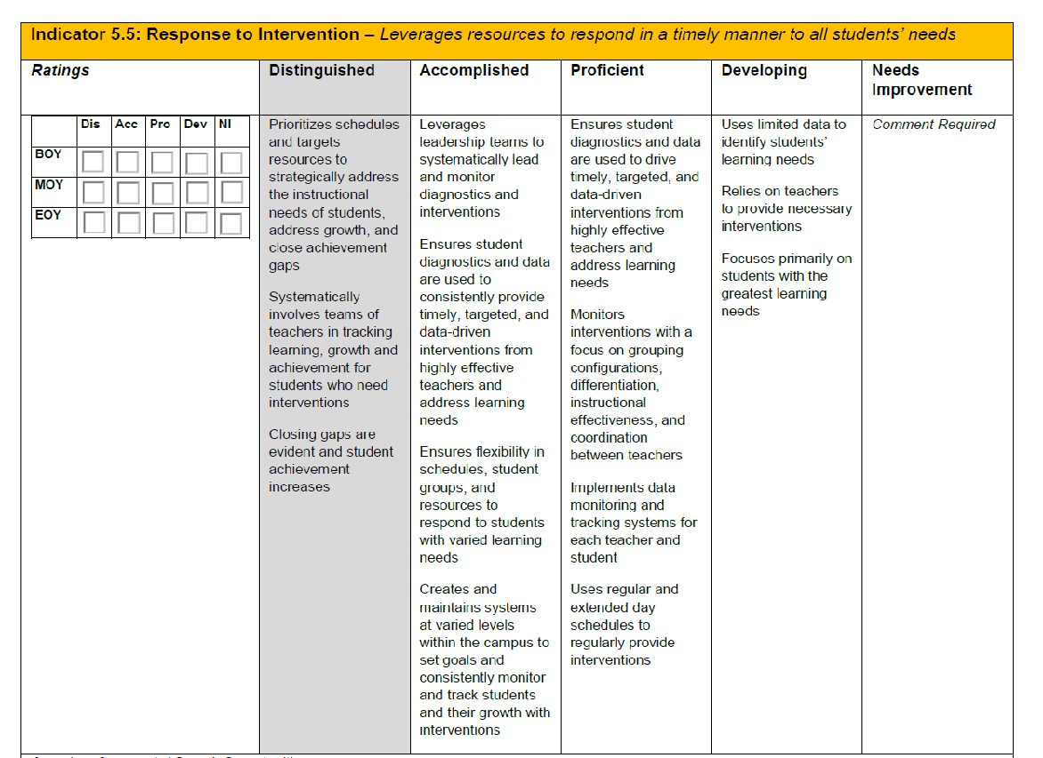
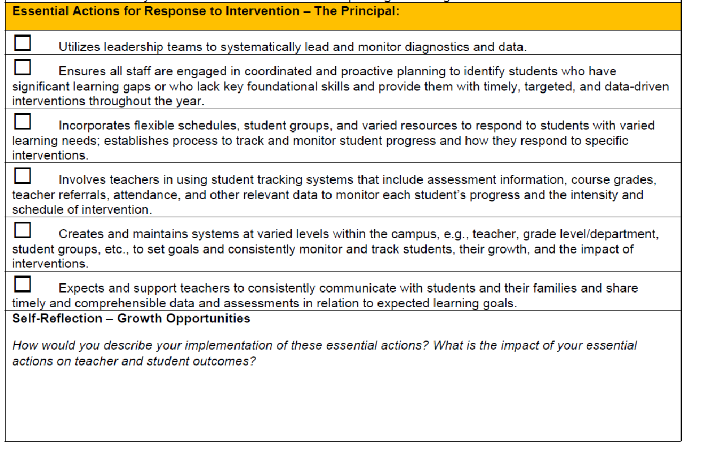
Identifying Areas for Professional Growth
Uti
Goal/Growth Opportunity
Notes:
2 minutes
Determine the evidence that best describes the current level of performance.
This review method, going descriptor by descriptor, identifies the next step to goal setting and professional growth. Principals are encouraged to self-select an area for growth from within the T-PESS Rubric by using this process. It is important for the principal to select an area of growth that he or she desires. The personal goal should NOT be a campus plan goal.
Professional growth goals pertain to the skills and abilities of the individual.

Slide 48
Goal Setting Form
State your goal here.
What rubric standards or indicators are related to your accomplishing the stated goal? List those here.
List the key steps you need to do to accomplish the goal.
How will you measure your goal attainment? List the outcomes relevant to goal attainment.
What is the timeline for when the goal should be completed? Are there deadlines for particular steps?
List any materials, resources, or special support you are dependent upon to complete your goal.
Additional comments, special conditions, or expectations pertaining to the goal
It is important that both the appraiser and the principal discuss and agree to the nature and expectation of the goal.
Notes:
3 minutes
NOTE: This slide has multiple transitions that highlight briefly explain each section of the T-PESS Goal Setting Form. Review the slide with participants making the connection between the sections of the form and the SMART criteria to be used for completing the form.
The T-PESS Goal Setting Form leads the principal through the goal setting process. Districts may design a local form if preferred.
(Click to highlight each section of the document. Take your time with this explanation.)
“This is the Beginning-of-year: Goal Setting Form. This form is intended to be used to set a single performance goal. Because of the dynamic and complex nature of school-level leadership, we strongly recommend that principals and their appraisers limit goal setting to the two required goals—one pertaining to principal practice and the other pertaining to student growth. Including too many goals limits the principal’s ability to focus and effectively execute his or her plan. In the end, districts may develop their own forms for goal setting. This is the example provided with T-PESS. It is the process that is paramount. The self-selection of a performance goal activates internal locus of control and personal motivation. Supervisors are collaborators in the process because they give feedback and help to refine the goal(s) set by the principal.
Each goal should focus on the connection between the goal and the T-PESS standards and indicators best believed to support goal attainment. Principals should carefully consider the actions and activities and the alignment of resources (Kaplan & Norton, 2008) that will most effectively accomplish the goal and improve their performance.

Slide 49
Two Goals
Professional Practice Goal
A professional practice goal is selected by the principal after reviewing the Standards of the T-PESS Rubric.
Student Growth Goal
A student growth goal should consider root causes of student performance and identify an area to improve over time.
Notes:
1 minute
We want to be sure principals understand they have an opportunity to write a goal that is specifically about their professional practice. It should be personal and meaningful to them while tied to the Standards of the Rubric.
The second goal, required by Commissioner’s Rule as of 2017-2018 is a Student Growth Goal.
For 2017-18 they will be crafting TWO goals—their Practice Goal and their Student Growth Goal.

Slide 50
Sample Goal To “Coach Up”
Professional Practice Goal
Professional Practice Goal: Evaluate the implementation of the district approved mathematics curriculum for the 20XX school year to ensure all students have access and teachers have the time to teach the curriculum
Texas Principal Standards and Indicators to be Addressed: Standard 1 Instructional Leadership. The principal is responsible for ensuring every student receives high-quality instruction Effective school leaders: (I) prioritize instruction and student achievement by developing and sharing a clear definition of high-quality instruction based on best practices from research; (II) implement a rigorous curriculum aligned with state standards; (III) analyze the curriculum to ensure that teachers align content across grades and that curricular scopes and sequences meet the particular needs of their diverse student populations; (IV) model instructional strategies and set expectations for the content, rigor, and structure of lessons and unit plans;(V) routinely monitor and improve instruction by visiting classrooms, giving formative feedback to teachers, and attending grade or team meetings.
Strategies and Actions: Bi-Monthly PLC meetings with grade level math teachers Quarterly benchmarking with other district high schools
Expected Measurable Outcomes: Improved unit design Use of common instructional planning template Development of formative assessments
Timeline for Achieving Goal: Submission of unit plan - quarterly Submission of formative assessments - quarterly
Resources Needed: Coverage for 9th grade teachers for planning and development - 4 days total
Professional Development: Consultation and collaboration with district math curriculum team to support
Comments:
Notes:
2 minutes
This is a sample annual goal that could use some “coaching-up.”
So let’s take a look at this goal… (read goal)
ASK: Do you consider this goal to be more related to an individual principal’s professional growth or is It more related to a District initiative?
Answer: Most people see this as more related to a district initiative. It is a worthy goal. We just want to be sure every principal in Texas has at least one goal that is tied to the development of his or her personal leadership skill and ability.
State: This goal could be slightly tweaked to focus in on the skill the principal has identified which is the capacity to EVALUATE implementation of a curriculum. The criteria that is identified includes students having access to the curriculum and teachers having time to teach the curriculum.

Slide 51
Sample Annual Goal—Revised Principal “Practice” Goal
Professional Practice Goal
Professional Practice Goal: I will strengthen my capacity to support and evaluate the effectiveness of implementation of the new math curriculum to ensure all students have access and teachers have time to teach the curriculum.
Texas Principal Standards and Indicators to be Addressed: Standard 1 Instructional Leadership. The principal is responsible for ensuring every student receives high-quality instruction: Effective school leaders: (I) prioritize instruction and student achievement by developing and sharing a clear definition of high-quality instruction based on best practices from research; (II) implement a rigorous curriculum aligned with state standards; (III) analyze the curriculum to ensure that teachers align content across grades and that curricular scopes and sequences meet the particular needs of their diverse student populations; (IV) model instructional strategies and set expectations for the content, rigor, and structure of lessons and unit plans;(V) routinely monitor and improve instruction by visiting classrooms, giving formative feedback to teachers, and attending grade or team meetings.
Strategies and Actions: Consult with district curriculum team regarding new curriculum Bi-Monthly PLC meetings with grade level math teachers Quarterly benchmarking with other district high schools
Expected Measurable Outcomes: Improved unit design Use of common instructional planning template Development of formative assessments
Notes:
2 minutes
Slightly Revised Annual Goal
State: Principals draft their personal goals and then meet with their supervisor to discuss. This is a collaborative process and the supervisor should be comfortable to provide feedback. In this case, with just a slight adjustment, the Annual Goal becomes more personalized and specific to the skill to be developed.
ASK: Do you believe the Leadership Standards and Indicators that have been selected are on target?
ASK: How about the strategies and actions the principal has identified? Do you see these as supporting the growth that is desired?
ASK: How about the time line for achieving the goal—does it appear realistic?
ASK: Are the resources within reason?
State: This is the process a supervisor will go through to provide feedback to the principal.
Allow for natural discussion that may arise.

Slide 52
Student Growth Goal
Student Growth is addressed in the form of a goal—just like Principal “Practice”.
This goal should be related to the improvement of student performance over time.
A growth goal may address that student progress can take more than one year.
Notes:
1 minute
Student growth is a critical component of T-PESS.
The inclusion of a student growth measure allows principals to focus on a particular area of concern as it relates to student performance, capture strategies and actions that should lead to improvement in that area and assess the impact the principal’s practices and leadership had on the student performance outcome.
For student growth to be a valuable tool in continuous improvement, principal supervisors should keep the following in mind:
Although it’s called student growth, it is really about principal growth;
Student growth is not the end in itself – the key to a meaningful student growth goal is the ability to translate the student growth outcomes into feedback on leadership practices;
Honest assessment of practice, sincere reflection on the approach to planning and implementation, and a commitment to adjusting leadership practices when targets aren’t met are the best ways to improve student growth;
Ratings are less important than the process of professional growth.
Go over this the slide, point by point. There is some new learning here as we introduce the idea that a growth goal can be set for a period of time longer than one year and that non-academic that influence student performance can also be considered such as attendance, discipline, etc.
Allow for audience reaction and brief discussion.

Slide 53
Ask Yourself…
If my school were to continue to make gains similar to those we’ve made in recent years, will we be making good progress?
If not, are there other factors that are impeding our progress such as attendance, or lack of curriculum or discipline concerns?
Which high-yield student goal should you consider to change the trajectory of the campus and results for students?
Notes:
3 minutes
Process the questions on the slide and allow for discussion.

Slide 54
Partner Discussion
Turn and talk with a neighbor about a possible student growth area for long-term focus.
The duration of the goal will depend on what is to be accomplished.
The goal will include short term, mid-way, and long term metrics—or measurement over time.
What ideas come to mind about possible student growth goals?
Just come up with one or two possibilities to share.
Notes:
2 minutes
We want to allow the audience time to really think about long term goals. They do not have to be certain of their goal at this time, but should have some practice with considering ideas and applying the idea of accomplishing a goal over time—short term, mid-way, and final assessment.
Turn and talk with a neighbor about a possible student growth area for long-term focus.
The duration of the goal will depend on what is to be accomplished.
The goal will include short term, mid-way, and long-term metrics—or measurement over time.
Ask: What ideas come to mind about possible student growth goals? Generate one or two possibilities to share.

Slide 55
Goal Setting and Professional Development Plan (GSPD)
The T-PESS GSPD plan is reviewed and revisited over the course of the year:
Beginning-of-the Year Goal Setting (Practice Goal & Student Growth Goal)
Mid-Year Progress Review toward Goal Attainment
End-of-Year Goal Attainment
Other times as helpful for professional reflection and feedback
Notes:
3 minutes
The T-PESS GSPD plan consists of three main parts (see #1 – 3) but may be reviewed and revisited as helpful throughout the year.
Beginning of the Year Goal Setting
Mid-Year progress toward Goal Attainment
End-of-Year Goal Attainment”
Other times as helpful for professional reflection and feedback
ASK for any questions or comments.

Slide 56
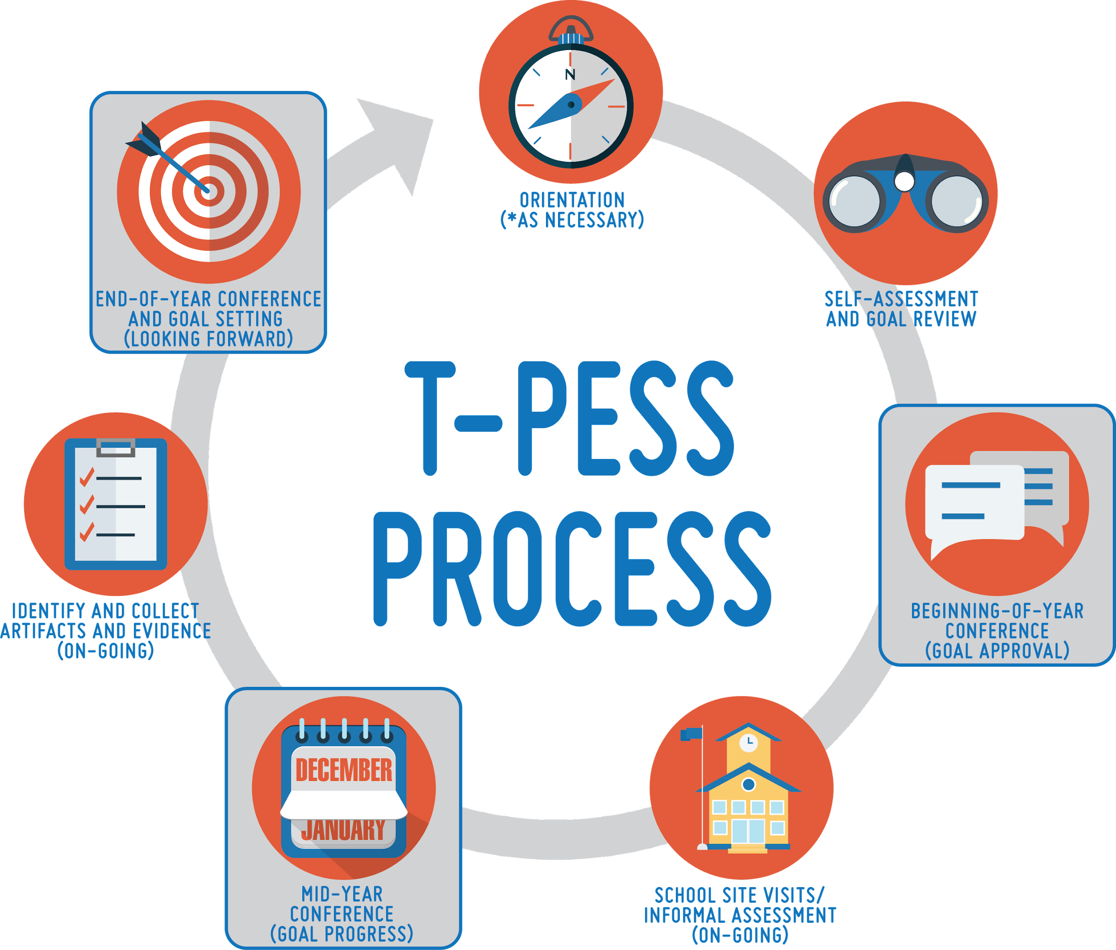
Step 3: Beginning-of-Year Conference
During this conference, the appraiser and principal discuss the self-assessment results, school and district priorities and plans, and any data or artifacts that proved useful in determining the growth goals.
Once the goals have been established, it is important to discuss and agree on the data, evidence, and documentation that will be collected throughout the year in support of the goals, how periodic reviews and support will be conducted, and the criteria for success.
Notes:
3 minutes
Take a minute to read what’s on the slide and make notes about the next step in the T-PESS process: Beginning of Year Conference.
Facilitator ensures a quiet environment for silent reading for 2 minutes. This activity is helpful to some of the adult learners in the room. The T-PESS graphic is helpful to others. We are trying to support everyone in gaining a strong conceptual understanding of the T-PESS process.

Slide 57
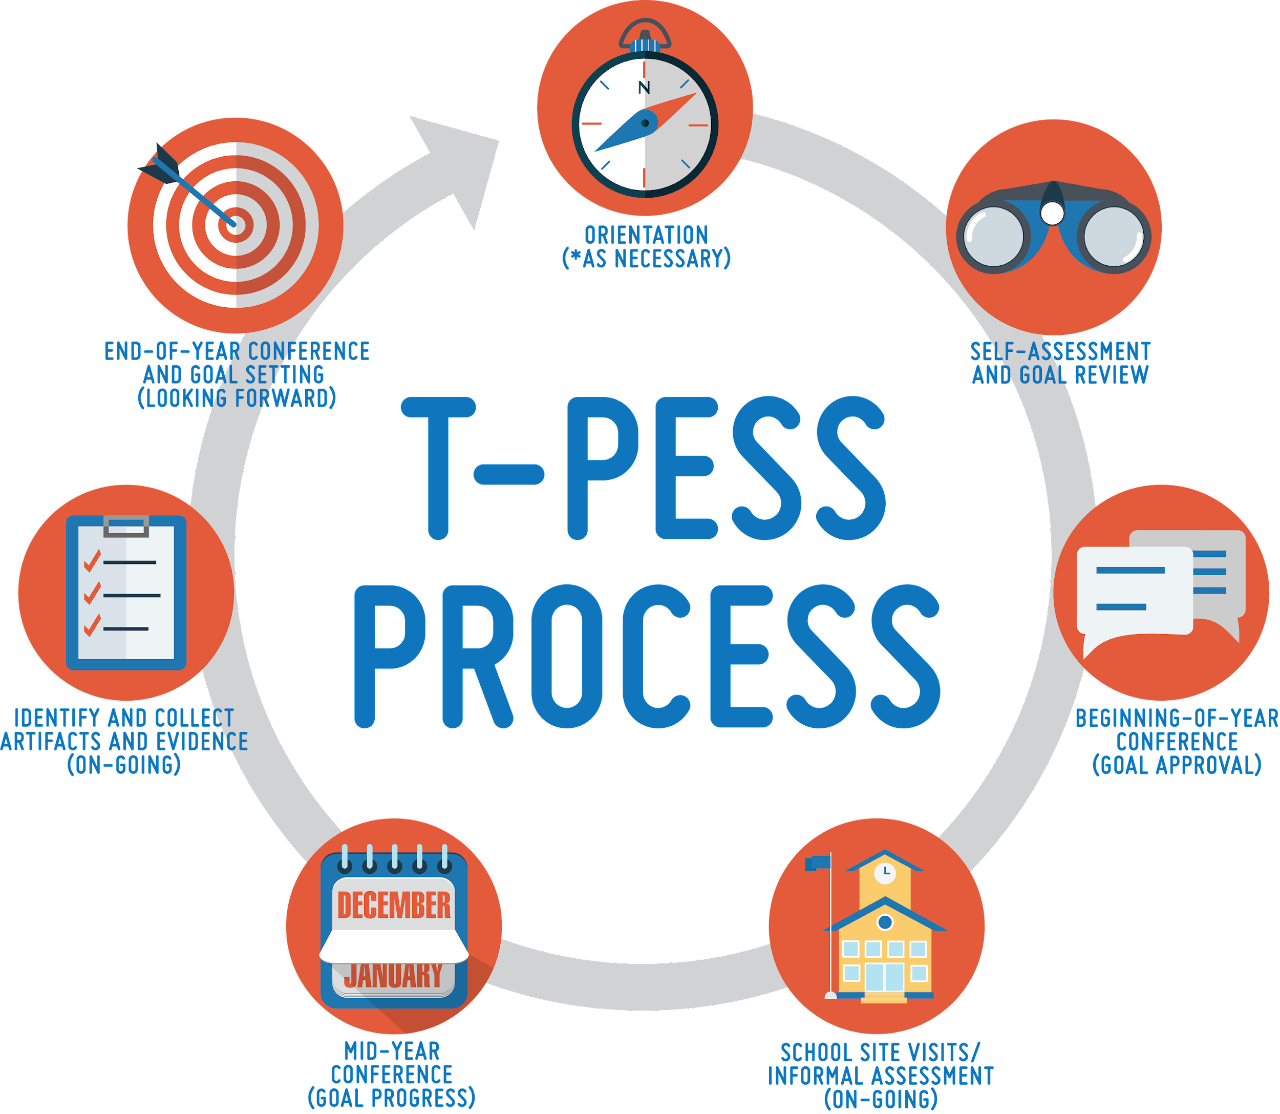
Step 4: Site Visits Informal Assessment (On-going)
Ongoing school visits are conducted to observe the campus environment, interact with the school community, gather evidence, coach, and provide actionable feedback regarding performance and practices in various contexts and settings.
Notes:
2 minutes
Take a minute to read the slide and make notes about the next step in the T-PESS process: Site Visits and Informal Assessment.
Facilitator ensures a quiet environment for silent reading for 2 minutes. This activity is helpful to some of the adult learners in the room. The T-PESS graphic is helpful to others. We are trying to support everyone in gaining a strong conceptual understanding of the T-PESS process.

Slide 58
Step 5: Mid-Year Conference
This midyear checkpoint is also used to formatively assess performance and practices using the T-PESS rubric, and to assess progress towards the goals.
Notes:
2 minutes
Take a minute to read through Step 5 on the slide.

Slide 59
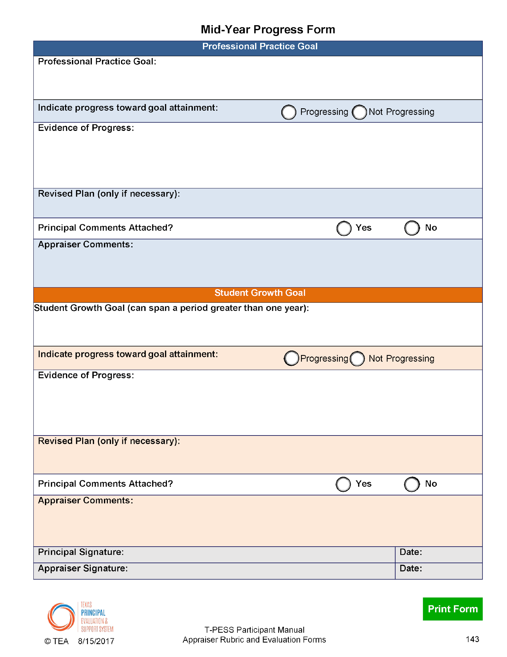
Mid-Year Progress Form
Notes:
2 minutes
The Mid-year Progress Form serves to capture dialogue and decisions discussed during the MOY conference. The appraiser and the principal complete the form based on the available data, artifacts, and evidence as agreed upon in the Beginning-of-year Goal Setting Conference.

Slide 60
Step 6: Collect Evidence & Artifacts (On-going)
Because T-PESS is an evidence-based process, it is imperative that the appraiser and principal must collect and prioritize evidence throughout the year. Each indicator of the T-PESS rubric provides numerous examples of artifacts and evidence.
Notes:
2 minutes
Take a minute to read and make notes about the next step in the T-PESS process: Beginning of Year Conference.
Make a connection to the evidence at the end of each Domain in the rubric.

Slide 61
Step 7: End-of-Year Conference & Goal Setting
An opportunity to discuss summative achievements from the year, including goal attainment, and to draft performance goals that reflect progress made and insights gained.
Afterwards, the appraiser will review all the data gathered, including information discussed during the EOY conference, when completing the Summative Annual Appraisal Report.
Notes:
3 minutes
Review Step 8 on the slide.

Slide 62
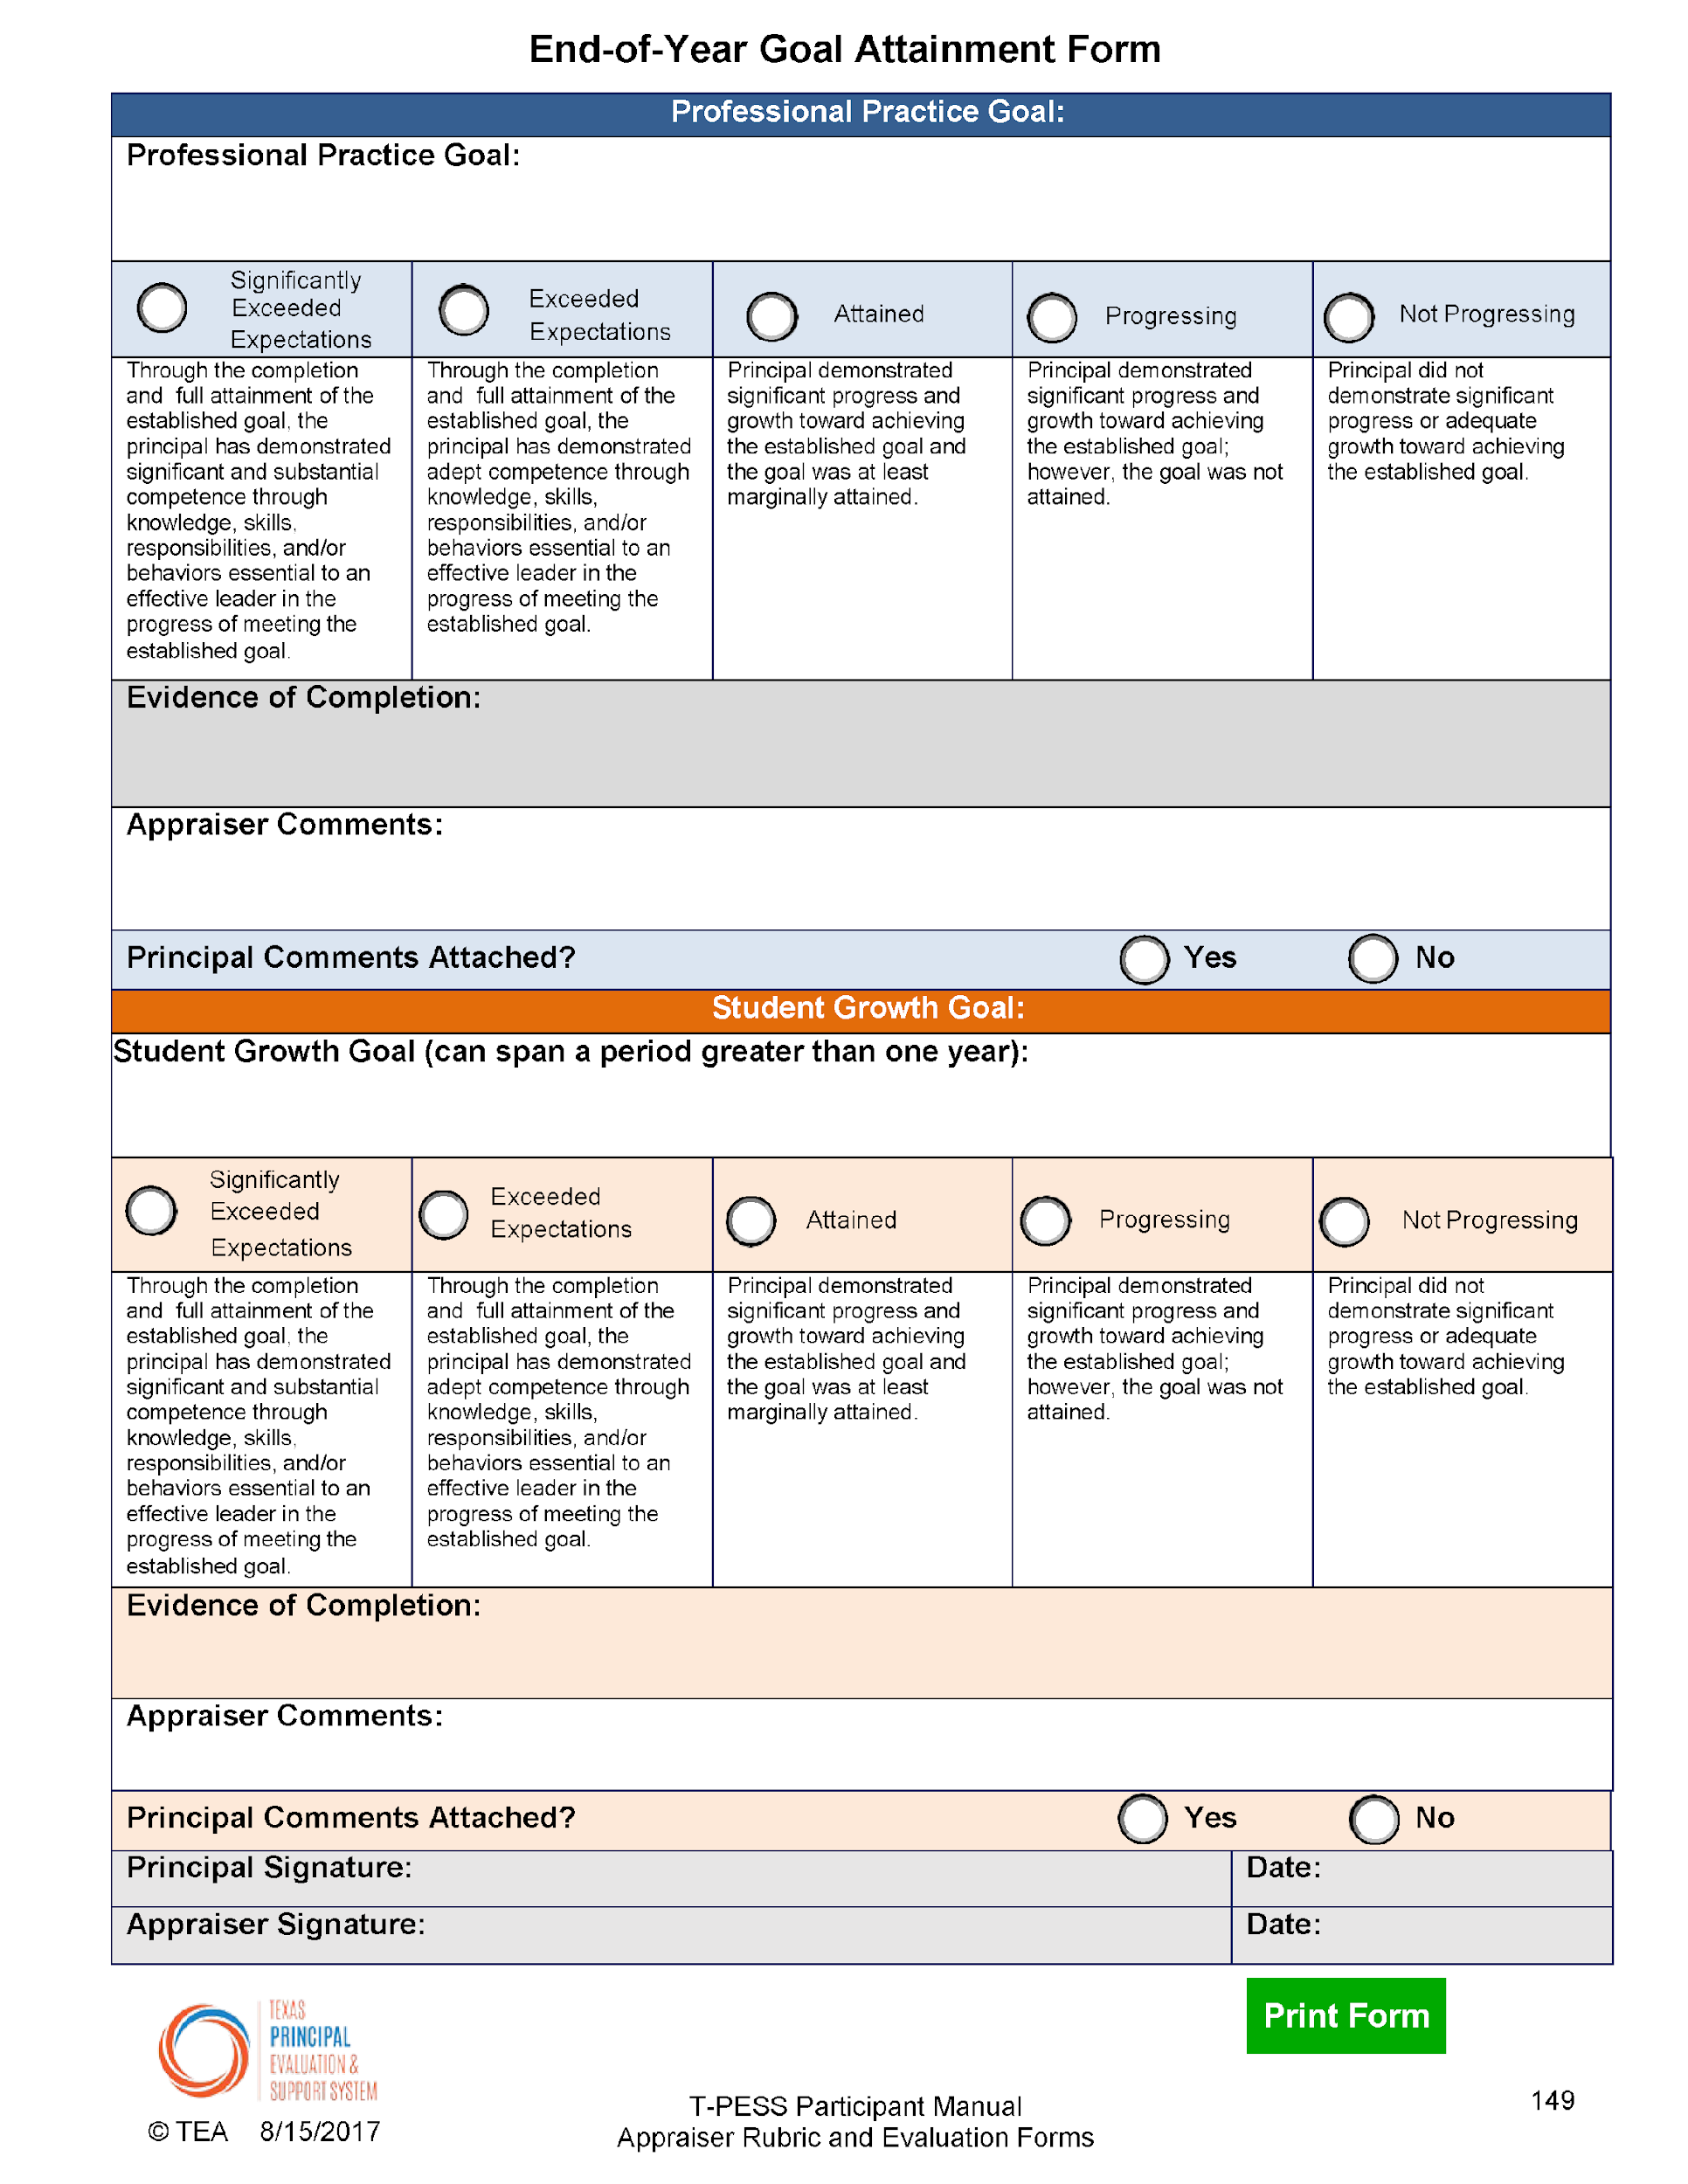
End-of-Year Goal Attainment Form
Notes:
3 minutes
The artifacts and evidence inform goal attainment, and, with the principal’s
input, decisions are made about final performance ratings using a preponderance of
evidence. That information is further used to project and establish draft performance goals
and performance refinements for the next school year as a cycle of continuous improvement.

Slide 63
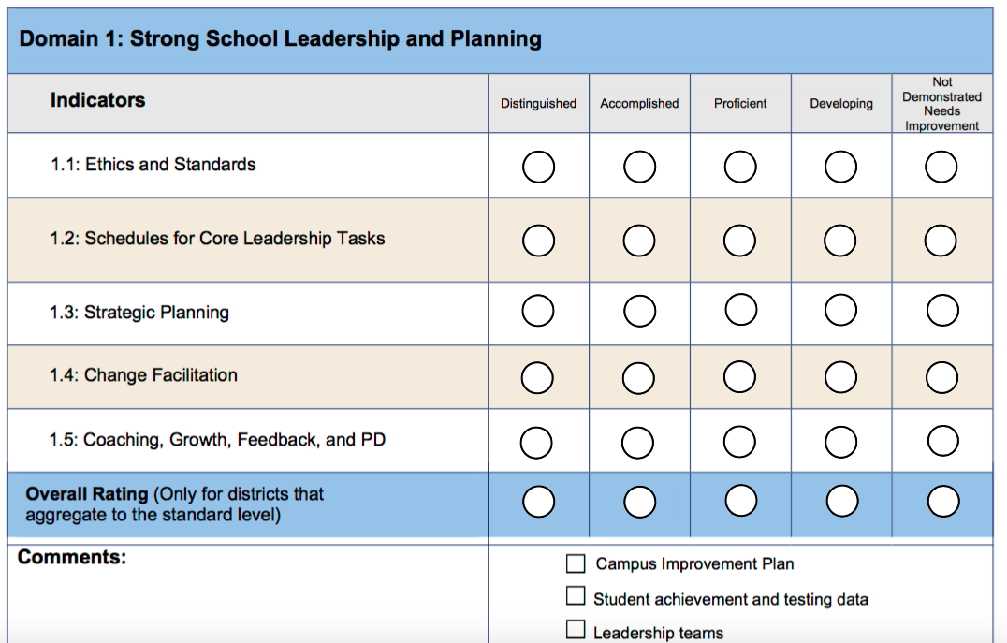
Summary Rating Form
Notes:
2 minutes
NOTE: THE OVERALL RATING SCORE IS NOT REQUIRED. Districts have the option of summative, domain, or indicator level scores.
The formative annual process of collecting performance data and providing constructive feedback rolls up to provide a Summary of the school-level leader’s performance. This “quick at a glance” form provide the appraiser with the data necessary to make final performance ratings.
In preparation for the End-of-year Performance Discussion, the appraiser should:
1. Review the performance goals,
2. Review the Mid-year Progress Form,
3. take stock of the information contained in the summary provided by the principal, and
4. reflect on the principal’s performance in relation to his or her goals, the Texas Principal Standards, and identified leadership practices.
This slide illustrates the Summary Rating Form. It is necessary to provide summary ratings for all indicators and an overall rating for each standard of T-PESS however districts are not required to provide an overall score for each Standard.
Indicator ratings should reflect the scoring rule (cumulative and additive). That score will transfer directly to the Summary Rating Form. If the district is using a single score for each standard, the overall score for each standard should take into account the indicator ratings and any artifacts, evidence, and data supporting performance related to a standard.
Note to Facilitator
You may want to review the rubric scoring rule. Doing so will help participants see the relationship between rubric scoring methodology and determining summary ratings.

Slide 64
New Electronic T-PESS Forms on TPESS.org
Notes:
3 minutes
Explain how forms will be accessed/available within the district.
The artifacts and evidence inform goal attainment, and, with the principal’s
input, decisions are made about final performance ratings using a preponderance of
evidence. That information is further used to project and establish draft performance goals
and performance refinements for the next school year as a cycle of continuous improvement.

Slide 65
Let’s Pause and Reflect
What questions are on your mind?
What clarification do you still need?
What new insights have you gained?
What are your next steps?
Notes:
5 minutes
Process the questions on the slide.

Slide 66
Moving Forward…Next Steps
Notes:
Closure—Talk about Next Steps with T-PESS in YOUR DISTRICT
Note to Trainers – some additional activities will be available to help facilitate ongoing discussion of T-PESS.

